Slide 1


Distributed file system NFS & GFS
SE3331-1 (2022 Fall)
Yubin Xia
IPADS, Shanghai Jiao Tong University
https://www.sjtu.edu.cn
Credits: Rong Chen@IPADS

Slide 2
Large-scale website so-far
Large-scale websites are composed of different distributed systems
Request processing, data storage
Caching server
Caching server
Caching server
…
Caching
Caching
Caching
Distributed caching
Database server
Database server
CDN
Users
Application #1
generate the page
Database
user, price
…
Database
user, price
Application server
Distributed database
Internet
Load
Balance
Application #2
add the order
File server
File server
File server
File:
image
File:
image
…
File:
image
Application server
…
…
Message queue
Distributed file system

Slide 3
Large-scale website so-far
Large-scale websites are composed of different distributed systems
Request processing, data storage
How each system communicates?
Caching server
Caching server
Caching server
…
Caching
Caching
Caching
Distributed caching
Database server
Database server
CDN
Users
Application #1
generate the page
Database
user, price
…
Database
user, price
Application server
Distributed database
Internet
Load
Balance
Application #2
add the order
File server
File server
File server
File:
image
File:
image
…
File:
image
Application server
…
…
Message queue
Distributed file system

Slide 4


Last lecture: Remote Procedure Call (RPC)
Allow a procedure to execute in another address space without coding the details for the remote interaction
RPC History
Idea goes back in 1976
RPC uses stubs to avoid handling argument encoding/decoding and send/receiving messages, message transports, etc.
How RPC handles failures?
Depends on the semantic: at-most-once, at-least-once & exactly-once

Slide 5
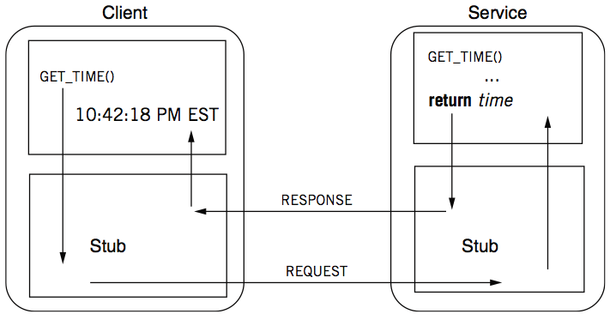
Review: RPC -- a complete calling process

Slide 6

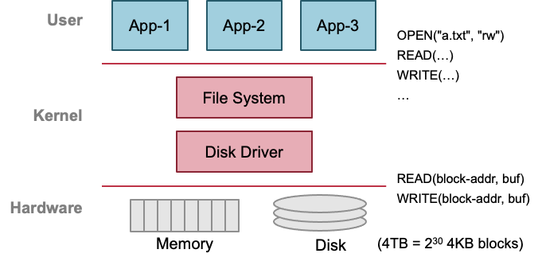
Previous lecture: single-machine file system
Storage as files
Caching server
Caching server
…
Caching server
Caching
Caching
Caching
Distributed caching
Database server
Database server
CDN
Users
Application #1
generate the page
Database
user, price
…
Database
user, price
Application server
Distributed database
Internet
Load
Balance
Application #2
add the order
File server
File server
File server
File:
image
File:
image
…
File:
image
Application server
…
…
Message queue
Distributed file system

Slide 7
With the help of RPC
We can now build distributed file system!

Slide 8
Distributed file system
Key components in distributed systems
Stores large blob of data, intermediate results, database/KV backends, etc.
Caching server
Caching server
Caching server
…
Caching
Caching
Caching
Distributed caching
Database server
Database server
CDN
Users
Application #1
generate the page
Database
user, price
…
Database
user, price
Application server
Distributed database
Internet
Load
Balance
Application #2
add the order
File server
File server
File server
File:
image
File:
image
…
File:
image
Application server
…
…
Message queue
Distributed file system

Slide 9
Ways for accessing remote files
Many familiar ways, FTP, telnet, …
Explicit access (knowing it is a distributed file system)
User-directed connection to access remote resource
We want more transparency(透明性)
Allow users to access remote resource just as local ones
即对于user而言，希望在使用RPC进行远程访问时函数使用方式应该与
local模式类似。

Slide 10
Distributed File Service Types
Upload/Download model
Read file: copy file from server to client
Write file: copy file from client to server
Advantage
Simple
Problem
Wasteful “what if client needs small pieces?”(只能下载/上传整个文件)
Problematic “what if client does not have enough space?”
Consistency “what if others modify the same file?”(此模式下client修改之后的新文件会先存储在client端，而server端还是老文件，这是如果另外的用户有去server上download并读写，就会与之前的那个修改但是未上传的文件不一致)

Slide 11
Distributed File Service Types
Remote access model
File service provide functional interface with RPC (create, delete, read, write, etc.)
Advantage
Client gets only what’s needed(client通过发送RPC的方式来访问对应部分)
Server can manage a consistent view of file system(此时新文件存在server端)
Problem
Possible server and network congestion(拥挤)
Servers are accessed for duration of file access
Same data may be requested repeatedly

Slide 12
NFS with RPC

Slide 13
NFS: Network File System
Design Goals (by Sun, 1980s, designed for workstations)
Any machine can be a client or a server
Support diskless workstations(使用了network进行传输)
Heterogeneous(多样的，异构的) system must be supported
Different HW, OS, underlying file system
Access transparency
Use remote access model
Recovery from failure
Stateless, UDP, client retries
High performance
Use caching and read-ahead
因为是stateless，所以在crash的时候恢复时不需要特殊的state恢复处理，只需要继续执行就行了。

Slide 14
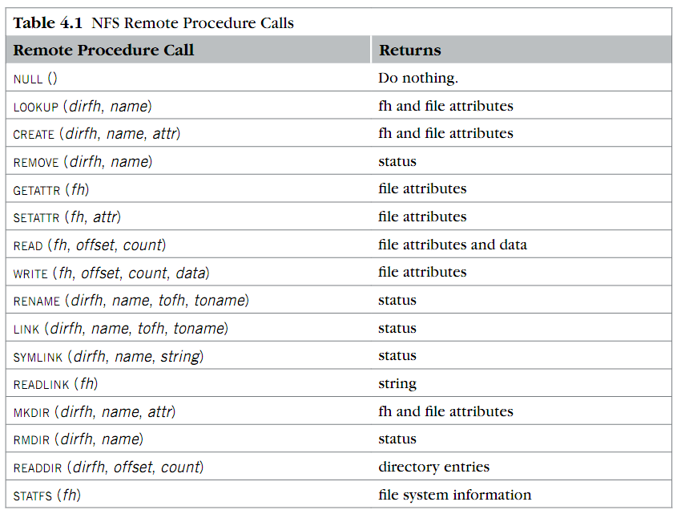
RPC used in NFS
Where is OPEN and CLOSE?
NFS系统没有定义OPEN与CLOSE对应的RPC，但是，client端与server端都有自己的open与close函数。

Slide 15
NFS Protocols: Mount
Protocol:
Request access to exported directory tree
Requests permission to access contents
Server returns file handle (fh)
Client: parses pathname
contacts server for file handle
Client: create in-memory VFS inode (vnode) at mount point internally points to remote files (client keeps state, not the server)
本地的client是stateful的，其会存储fd-table，file-table等state，但是NFS server
是stateless的。

Slide 16
NFS Protocols: Mount
Static mounting
mount request contacts server
Server:
add list of shared directories to /etc/exports
Client:
mount 192.168.1.100:/users/paul /home/paul

Slide 17
NFS Protocols: Lookup/READ/WRITRE...
Directory and File Access Protocol:
Access files and directories (read, mkdir, …)
First, perform a lookup RPC
Returns file handle(作用类似于client端的fd，是对于server端文件的特殊标识) and attributes
lookup is not like open
Establish state on the client only (no information on server)
Call the NFS lookup function
The handle passed as a parameter for other file access function
e.g., read(handle, offset, count)

Slide 18
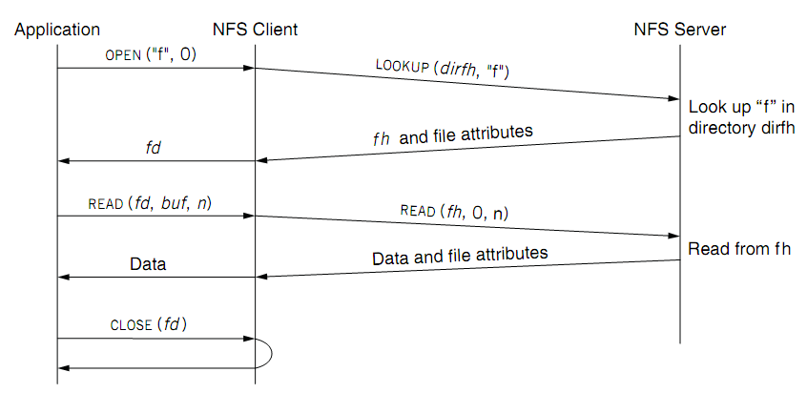
Read a file of NFS
fd <--> fh (file handler)
No state after open()

Slide 19
对于上一页PPT的补充
1.application与NFS client属于local client部分，NFS server属于remote部分。
2.NFS中没有OPEN CLOSE的RPC，要想open远端文件是先调用LOOKUP RPC.并且在向远端发送RPC时都需要经过NFS client的预处理，如此处的dirfh，后面的buf去除，获取read范围等。
3.若对应文件存在于远端的对应目录中，则返回fh以及arttribute(size,atime,ctime等，用于记录对于文件的操作信息)
4.在client端发送read的RPC之前，NFS client会先将buf去除，转化为对应的offset与读取的count信息，因为在RPC中只能传输pointerless数据(recall),因而RPC中参数中只有fh 0 n几项。这里要注意，NFS server端的read是幂等的，即每次都默认从offset=0位置开始读取大小为n的数据。这是因为server端是stateless的，不会存储文件读取到的cursor的信息，所以需要在NFS client进行cursor等state的存储，并在发送RPC之前进行解析从而获取正确的n和offset(这也侧面说明了NFS client的read是非幂等的。)
5.read之后若成功，需要解析返回的data(recall)
6.为何没有CLOSE的RPC，即为何close只在NFS client处处理时候就结束了呢？因为NFS client是stateful的，其存储了fd-table等存储于memory中的state，在进行close时候需要删除此次open对应的state，所以需要在client处执行，而server端的OPEN与CLOSE是stateless的，即不需要存储fd-table信息，所以不需要删除对应的state，所以也就不需要对应的RPC了。

Slide 20
NFS Protocols: Lookup/READ/WRITRE...
NFS has 16 functions (version 2)
null
lookup
link
symlink
readlink
getattr
setattr
create
remove
rename
statfs
mkdir
rmdir
readdir
read
write

Slide 21
File Handler for a Client
File handler contains three parts
File system identifier: for server to identify the file system
inode number: for server to locate the file
Generation number: for server to maintain consistency of a file
Can still work across server failures
E.g., server reboot
Q: Why not put path name in the handle?
类似于版本号

Slide 22
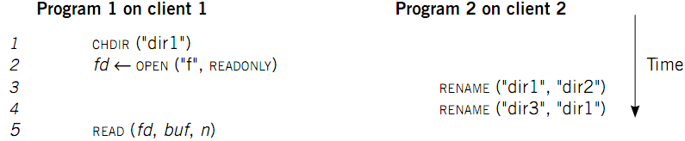
Case 1: Rename After Open(一个进程打开文件，另外一个改了文件名)
UNIX Spec:
Program 1 should read "dir2/f"
NFS should keep the spec

Slide 23
Stateless on NFS server
Stateless on NFS server
Each RPC contains all the information
Q: What about states like file cursor?
Client maintains the states, including the file cursor
Client can repeat a request until it receives a reply (at least once)
Server may execute the same request twice
Solution: each RPC is tagged with a transaction number, and server maintains some "soft" state: reply cache
Q: What if the server fails between two same requests?
不会有很大影响，因为server端的request都是stateless的，即为幂等操作，所以crash
只需要简单的retransmission就行了。
Notes:
What about the case of "delete-after-open"?

Slide 24
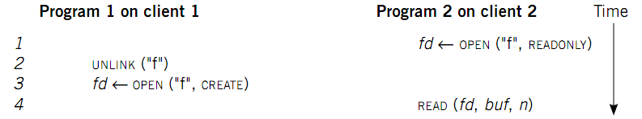
Case 2: Delete After Open
UNIX spec:
On local FS, program 2 will read the old file
How to avoid program 2 reading new file?
Generation number
"stale file handler"
Not the same as UNIX spec! It's a tradeoff...
unix下不会出现读取新文件内容的问题，
(recall),因为unix下出现上述情况时，
即使被删除了但是open的文件未被close
时其对应的inode是不会被释放的。即
在上述program2中参数fd对应的inum
还是old-file中inum。但是需要注意的是，
在server端由于是stateless的，所以发生
delete after open会导致文件直接被删除
，这是就出现了server与client端文件的
冲突。
类似于版本号

Slide 25
NFS performance
Usually slower than local(使用了network)
Faster example: server store file in memory, and the network is super fast
Improve by caching at client
Goal: reduce number of remote ops
Caching: read, readlink, getattr, lookup, readdir
Cache file data at client (buffer cache)
Cache file attribute information at client
Cache pathname bindings for faster lookup
Server side
Caching is “automatic” via buffer cache
All NFS writes are write-through to disk

Slide 26
Cache on the Client
NFS client maintains various caches
Stores a vnode for every open file
Know the file handles
Recently used vnodes, attributes, recently used blocks, mapping from path name to vnode
Cache benefits
Reduce latency
Less RPC, reduce load on server
Cache coherence is needed

Slide 27
Coherence(一致性，相干性)
Type-1: Read/write coherence
On local file system, READ gets newest data
On NFS, client has cache
NFS could guarantee read/write coherence for every operation, or just for certain operation(即每次进行read/write操作之后都需要写回server，会导致cache的浪费以及read以及write的低效。)
Type-2: Close-to-open consistency
Higher data rate
GETATTR when OPEN, to get last modification time
Compare the time with its cache
When CLOSE, send cached writes to the server(每次close时都将新的write直接write到server中去。)
Notes:
Mixed blocks, old and new

Slide 28
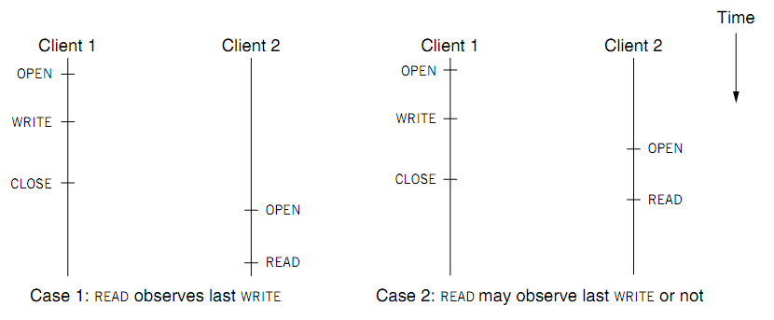
Coherence
Two cases of close-to-open consistency
case1保证了read读取的是最新write进来的数据，但是case2不能保证read与write的顺序。
More contents of consistency in chapter 9 and 10

Slide 29
VFS: Extend the inode-based FS to support NFS
Vnode
Abstract whether a file or directory is local or remote
In volatile memory (why?)
Support several different local file system
Where should vnode layer be inserted?
Vnode API
Same as we learnt: OPEN, READ, WRITE, CLOSE…
Code of fd_table, current dir, file name lookup, can be moved up to the file system call layer

Slide 30
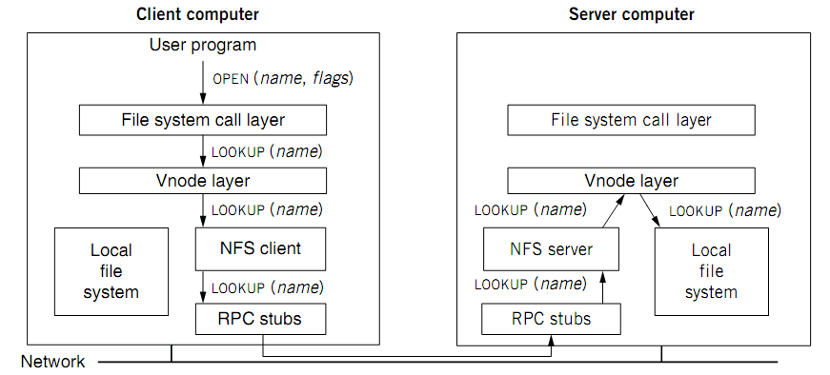
VFS: Extend the inode-based FS to support NFS

Slide 31
Accessing Remote Files
Implement the client module as a FS under VFS
System Call Interface
VFS
Sockets
ext4
procfs
RemoteFS
Network Protocols
Network
NIC
Abstracted with the RPC interface
& client-side cache

Slide 32
Validation
Inconsistencies may arise in NFS
1.通过比较最后一次的修改时间，来判断是否存在不一致的情况，若远端的更新，就要把client段的cache给flush掉，
2.若block修改-->dirty，close-to-open coherence。
Resolve inconsistencies with validation
Both server and client save timestamp of files
When file opened or server contacted for new
Compare last modification time
If remote is more recent, invalidate cached data
Always invalidate data after some time
open files (3 sec), directories (30 sec)
If data block is modified, it is:
Marked dirty, then flushed on file close

Slide 33
Improving Read Performance
Transfer data in large chunks
8KB default
Read-ahead
Optimize for sequential file access
Send requests to read disk blocks before they are requested by the applications
一次多传
提前多读入一些

Slide 34
Problem with NFS
File consistency
Assumes synchronized clock (a global clock)
We have mentioned in lecture02, it's challenging
Locking cannot work
Separate lock manager added (stateful)
No reference counting of open files (stateless server)
You can delete a file opened by yourself/others
And many more …

Slide 35
NFS is continuously improving
Version 3
Version 4
User-level lock manager
NVRAM support
Adjust RPC retries dynamically
Client-side disk caching
Support 64-bit file sizes
TCP support and large-block transfers
Commit operation
…
More state: control of caching, notify of file changes
Server export a single name space (pseudo file system)
Compound RPC support
Extended attribute and ACL
Negotiate security mechanism on mount
…

Slide 36
Reference Materials
RFC 1831: RPC Specification
http://www.ietf.org/rfc/rfc1831.txt?number=1831
RFC 1832: XDR Specification
http://www.ietf.org/rfc/rfc1832.txt?number=1832

Slide 37
GFS
The Google File System
Sanjay Ghemawat, “The Google File System”. SOSP, 2003

Slide 38
GFS design goals
更加适用于商务场景
Scalable distributed file system
E.g., Can NFS stores a very large file?
Designed for large data-intensive applications
Essential for distributed computing frameworks, e.g., MapReduce (next lecture)
Fault-tolerant; runs on commodity hardware
E.g., what if a server crashes, in the case of NFS?
Delivers high performance to a large number of clients

Slide 39
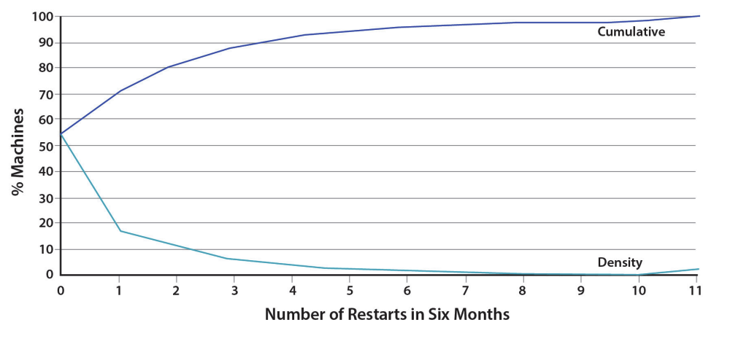
Design Assumptions
Assumptions for conventional file systems don’t work
E.g., “most files are small”, “short lifetimes”
Component failures are the norm, not an exception
File system = thousands of storage machines
Some % not working at any given time (recall from lecture2)
Machine failures at Google. Source: An Introduction to the Design of Warehouse-Scale Machines

Slide 40
Design Assumptions: environments
Assumptions for conventional file systems don’t work
E.g., “most files are small”, “short lifetimes”
Component failures are the norm, not an exception
File system = thousands of storage machines
Some % not working at any given time (recall from lecture2)
Files are huge: n-GB/TB files are the norm
I/O ops and block size choices are affected

Slide 41
More Design Assumptions: File Access
Most files are appended, not overwritten
Random writes within a file are rare
Once created, files are mostly read; often sequential
Workload is mostly:
mostly reads: large streaming reads;
large appends;
hundreds of procs append to a file concurrently
We should
designing the FS API with the design of apps benefits the system

Slide 42
GFS interface
GFS does not have a standard OS-level API
No POSIX API
No kernel/VFS implementation
It provides user-level API
Operations
Basic ops: create/delete/open/close/read/write
Additional ops: snapshot/append
Not supported ops: link, symlink
Notes:
The assumptions are just listed in the paper, lack a detailed descriptions

Slide 43
GFS architecture
A GFS cluster = 1 Master + N Chunkservers
chunk server
chunk server
chunk server
Master
. . .
chunk server
File system metadata
Maps files to chunks
chunk server
Data Storage: fixed-size chunks
Chunks replicated on several system

Slide 44
GFS files
A File is made of 64MB chunks, possibly spawn multiple machines
That are replicated for fault-tolerance
Chunks live on chunkservers
chunkserver
chunkserver
chunkserver
checkpoint image
operation log
The master manages the file system namespace
master
In-memory FS metadata

Slide 45
GFS in Google cluster
Google cluster environment
Core services: GFS + cluster scheduling system
Typically, 100s to 1000s of active jobs
200+ clusters, many with 1000s of machines
Pools of 1000s of clients
4+ PB filesystems, 40GB/s read/write loads
Job-1
Job-2
Job-3
Chunk Server
Scheduling Slave
GFS Master
File system Master
. . .
Linux
Scheduling Master
Job Scheduler
Commodity Hardware

Slide 46
Chunks and Chunkservers
Chunk size = 64 MB (default)
32-bit checksum with each chunk
Chunk handle
Globally unique 64-bit number
Assigned by the master when creation
Chunks are stored on local disk as Linux files (aka. file system overlay)
Each chunk is replicated on multiple nodes
Three replicas (default)
More replicas for popular files to avoid hotspots
类似于inode系统中的block id

Slide 47
Master
Maintains all file system metadata
Namespace, access control info, filename to chunks mappings, current locations of chunks
Manages
Chunk leases (locks), garbage collection, chunk migration
Master replicates its data for fault-tolerance
Periodically communicates with all nodes
Via heartbeat messages
To get state and send commands

Slide 48
Client-GFS interaction model
GFS client code linked into each app
No OS-level API
Interacts with master for metadata-related ops
Interacts directly with chunkservers for data
Master is not a point of congestion
No caching: neither clients nor chunkservers cache data
Except for the system buffer cache
Clients cache metadata
e.g., location of a file’s chunks
Notes:
Why no caching? “Client caches offer little benefit because most applications stream through huge files or have working sets too large to be cached.”

Slide 49
GFS uses one master, why? Make the design simple
All metadata stored in master’s memory
Super-fast access
Namespaces and name-to-chunk maps
Stored in memory
Also persist in an operation log on the disk (talk about in later chapters)
Don’t store chunk location persistently
This is queried from all the chunkservers at startup
Can keep up-to-date: master controls all the management
Benefits: simpler for consistency management
此处的namespace既类似于inode系统中
目录结构中的name-inum的映射关系

Slide 50
Next design decision: Why Large Chunks?
Default chunks size = 64MB
compare to Linux ext4 block size: 4KB~1MB
Benefits:
Reduces need for frequent communication with master for chunk location info
Makes it feasible to keep a TCP connection open for an extended time
Establishing a TCP connect can be costly
Master stores all metadata in memory(减少了存储压力)

Slide 51
Reading a file in GFS
Reading a file is simple in GFS
1. Contact the master
2. Get file’s metadata: chunk handles
3. Get the location of each of the chunk handles
Multiple replicated chunkservers per chunk
4. Contact any available chunkserver for chunk

Slide 52
Writing a File in GFS
Less frequent than reading
But is more complex, e.g., what about consistency?
GFS adopts a relaxed consistency model
E.g, may have inconsistency state, but work well for their apps
Benefits: simple & efficient to implement
Master grants a chunk lease to one of the replicas
This replica will be the primary chunkserver
The only one that can modify the chunk
Primary can request extensions (of lease), if needed
Master increases the chunk version number and informs replicas

Slide 53
Writing a File in GFS: Two-phases
primary：起到通讯作用的
chunkserver，对于同一个
chunk的不同chunkserver，
只能与primary server进行
通信，之后由primary将通信
的数据同步到其他的secondary
server上面去。
Phase 1: send data
Deliver data but don’t write to the file
A client is given a list of replicas
Identifying the primary and secondaries
Client writes to the closest(不一定是primary) replica
Pipeline forwarding
Chunkservers store this data in a cache (in memory)
此阶段send data的接收顺序不重要
Client App
chunkserver
1
chunkserver
2
chunkserver
3
Notes:
Why two phases? Primary should guarantee the same order for applying chunks.

Slide 54
Writing a File in GFS: Two-phases
Phase 2: write data
Add the data to the file (commit)
Client waits for replicas’ ack of receiving data
Send a write request to the primary
The primary is responsible for serialization of writes (applying then forwarding)
Once all acks have been received → The primary sends ack the client
secondary chunkserver
Client App
Primary chunkserver
secondary chunkserver

Slide 55
Writing a File in GFS: Two-phases
Data flow (phase 1) is different from control flow (phase 2)
Data flow
Client → chunkserver → chunkserver → ...
Order does not matter
Control flow
Client → primary → all secondaries
Order maintained (also for concurrent writes from multiple clients)(一定是从primary开始)
Chunk version numbers are used to detect if any replica has stale data
Is maintained by the primary chunkserver
If a replica has stale data, it shall be replaced

Slide 56
Naming in GFS: namespace
此处namespace存储内容与inode端类似，
但是并没有实现目录以及LINK。使用的一个
single Lookup Table。
No per-directory data structure like most file systems
E.g., directory file contains names of all files in the directory
No aliases (i.e., no hard or symbolic links)
Namespace is a single lookup table
Maps pathnames to metadata
Like a key-value store
只使用single lookup table优缺点：
pros：查找某个特定文件是要快于dir的。
cons：
1.进行readdir(ls)操作时会很慢，因为其
不能向dir一样通过解析路径来获取特定的目录来
减小范围，而只能通过遍历所有文件名的方式
来找符合条件的文件，所以慢。(e.g.:/home/a
在dir中是一个路径，而在GFS中就是一个文件名)
2.不好处理同名文件(dir在不同路径下可以有同名
文件，但是GFS中只存了name，所以需要额外
标记)
3.不好处理rename情况(但是在Google场景中少)

Slide 57











HDFS: another popular (open-source) DFS
Hadoop Distributed FS
Primary storage system for Hadoop apps
A framework that allows for the distributed processing of large data sets across clusters of computers

Slide 58
Design Goals & Assumptions of HDFS
HDFS is an open source (Apache) implementation inspired by GFS design
Similar goals as GFS
Run on commodity hardware
Highly fault tolerant
High throughput & large-scale deployments
…

Slide 59
Recall GFS files
A File is made of 64MB chunks, possibly spawn multiple machines
That are replicated for fault-tolerance
Chunks live on chunkservers
chunkserver
chunkserver
chunkserver
checkpoint image
operation log
The master manages the file system namespace
master
In-memory FS metadata

Slide 60
HDFS files
A File is made of 64MB blocks, possibly spawn multiple machines
That are replicated for fault-tolerance
Blocks live on DataNodes
DataNode
DataNode
DataNode
FSImage
EditLog
NameNode
The NameNode manages the file system namespace
In-memory FS metadata

Slide 61
Summary
Designing distributed file system (DFS) is not simply
Single-node file system + RPC
Many design choices for performance, consistency model & failure handling
Interface
Caching
Access model
Two case studies
NFS: transparent access files on a remote server
GFS: highly-scalable & fault-tolerant DFS optimized for Google’s workload
We will see some typical workloads in the next lecture

Slide 62
GFS or NFS are not Perfect
NFS
Can not scale
Is not fault-tolerant (注意re-excution并不是fault tolerance，因为已经fail了)
But is well-enough for many workloads, e.g., sharing the data for experiments in the lab
GFS
Relaxed consistency model: the results of concurrent mutations are undefined
Single-node master: single point of failures (though next-generation of GFS refines this)
Work well in Google’s datacenter workloads

Slide 63
GFS or NFS are not Perfect
NFS
Can not scale
Is not fault-tolerant
But is well-enough for many workloads, e.g., sharing the data for experiments in the lab
GFS
Relaxed consistency model: the results of concurrent mutations are undefined
Single-node master: single point of failures (though next-generation of GFS refines this)
Work well in Google’s datacenter workloads
We will see system principles to cope with them in future lectures.
For other workloads (e.g., Database) may not sufficient.

